Slide 1
Roman Urdu Chat-bot
Group Members: Syed Ahmer Mashhadi (EP-1450106) Amaan Ullah (EP-1450008) Fardan Akhter (EP-1450020)

Slide 2
Introduction
A Chat-bot is a program that attempts to (or pretends) to stimulate the conversation of a human being.
Chat-bots can be Text-based or Voice-based.
The usage of Machine Learning applies as to improving the accuracy of their Natural Language processing and recognition capabilities.
Chat-bots can be either Stateless or Stateful.
If the Bot is sophisticated enough to pass the Turing Test, a person cannot know if they are interacting with a computer or a human.

Slide 3
Applications of Chat-bots
Increase in Customer Lifetime Value.
Chat-bots help maintain brand consistency.
Monitor your brand’s perception.
Collect and Integrate Product Feedback.
They help save Development Cycles.

Slide 4
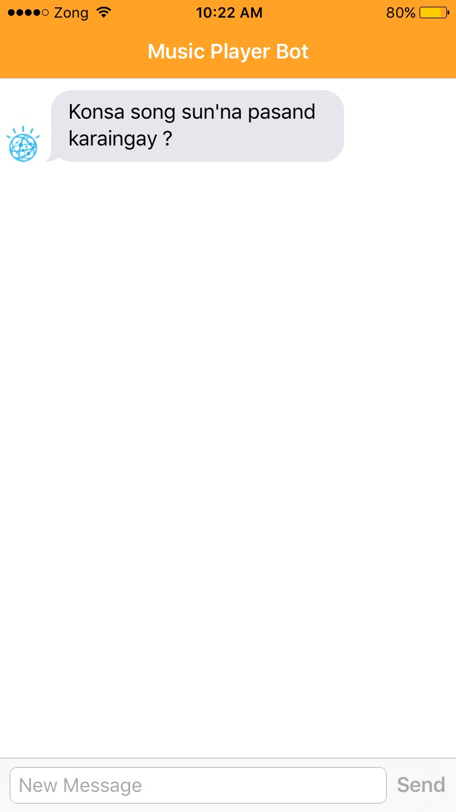
The Application (Media Player Bot)
Application is limited to the Media Player Domain (audio).
The bot inquires you in Roman Urdu about what song that you would like to listen

Slide 5
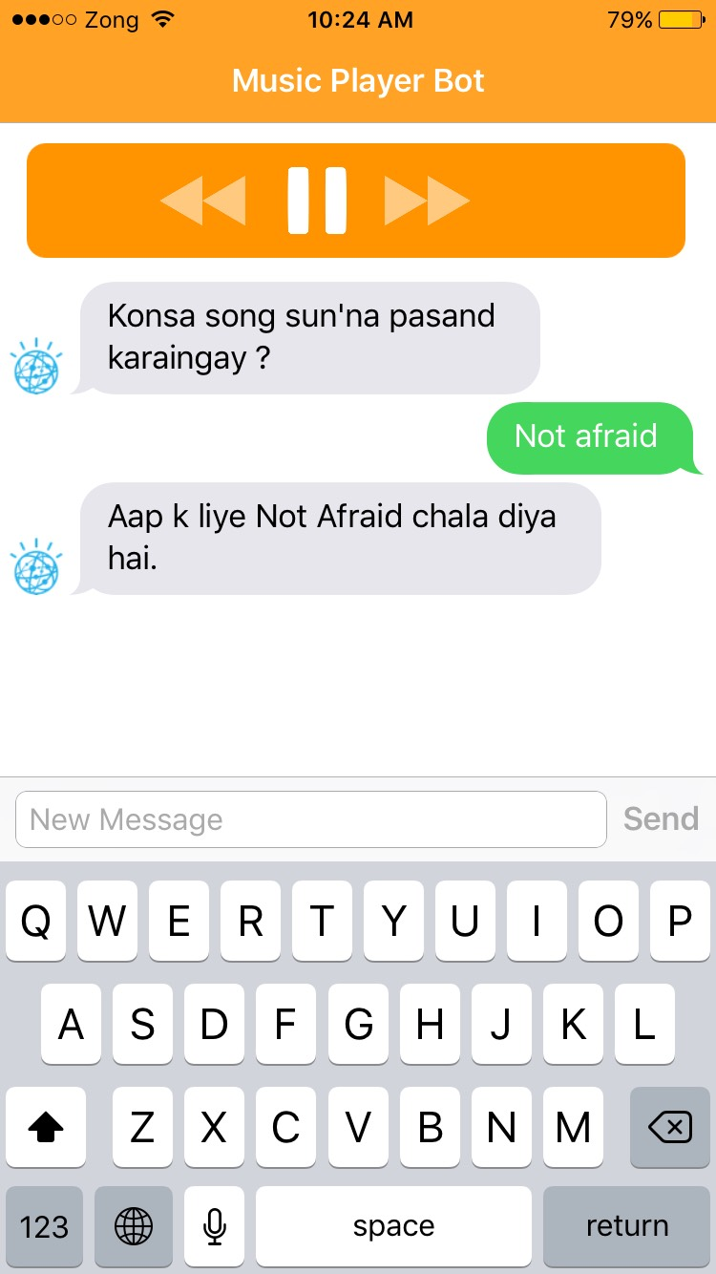
The Application (Media Player Bot)
As per your response the application chooses to play the specific song.

Slide 6
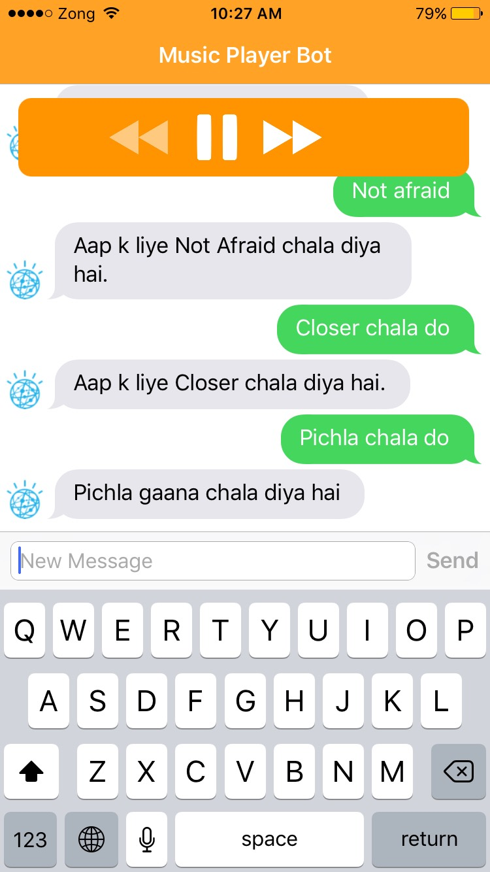
The Application (Media Player Bot)
The bot will remain silent awaiting response.
You can tell the bot to play the previous song.

Slide 7
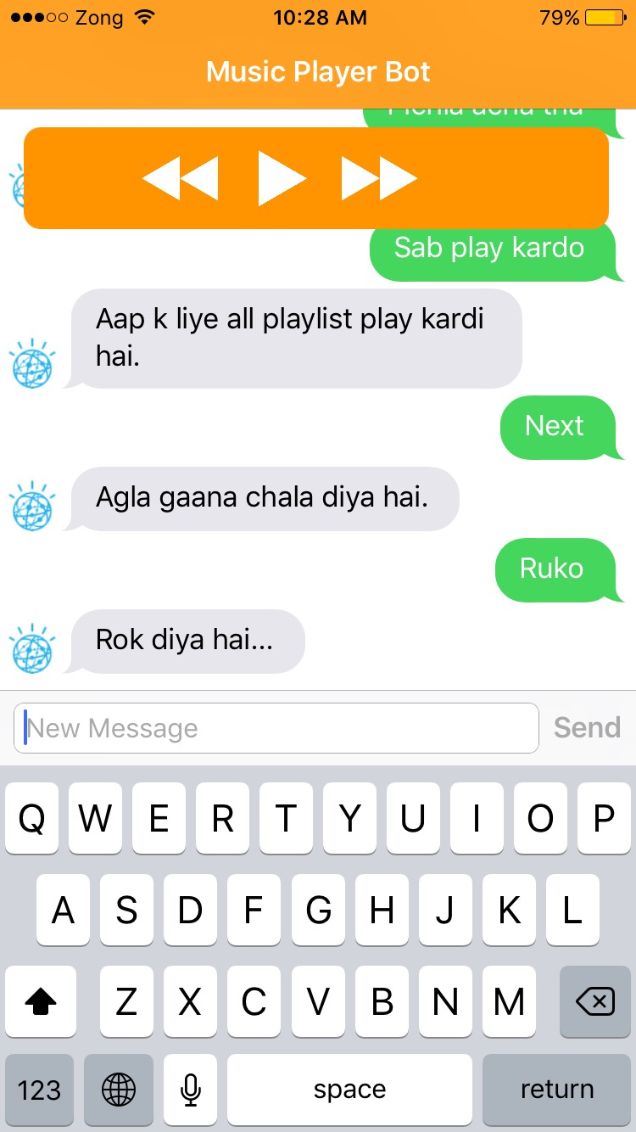
The Application (Media Player Bot)
You can also ask the bot to play all the songs as a playlist.
Playing next song is possible within a playlist

Slide 8
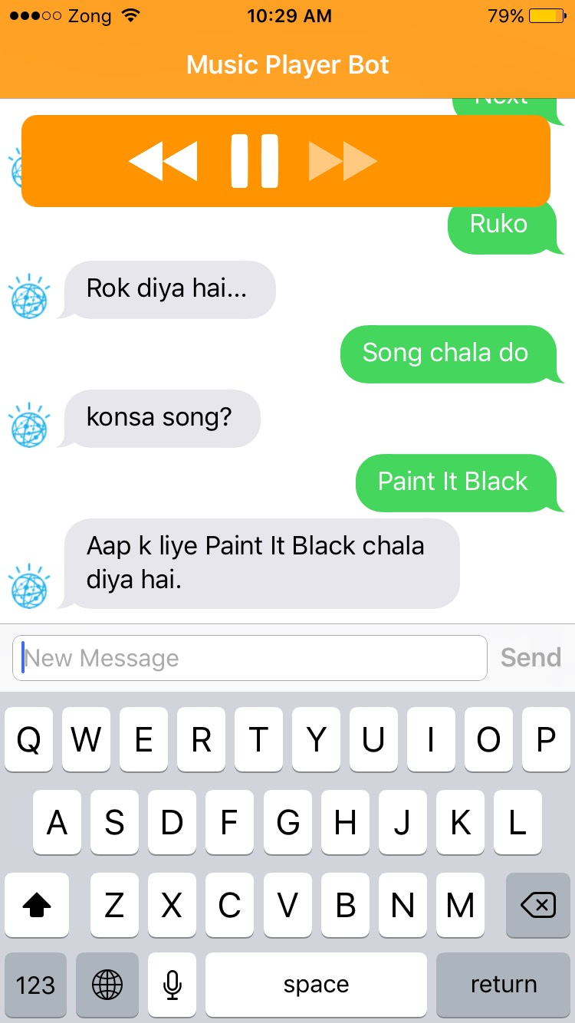
The Application (Media Player Bot)
The bot will also realize and ask back if it does not understand the song it is asked to play.

Slide 9
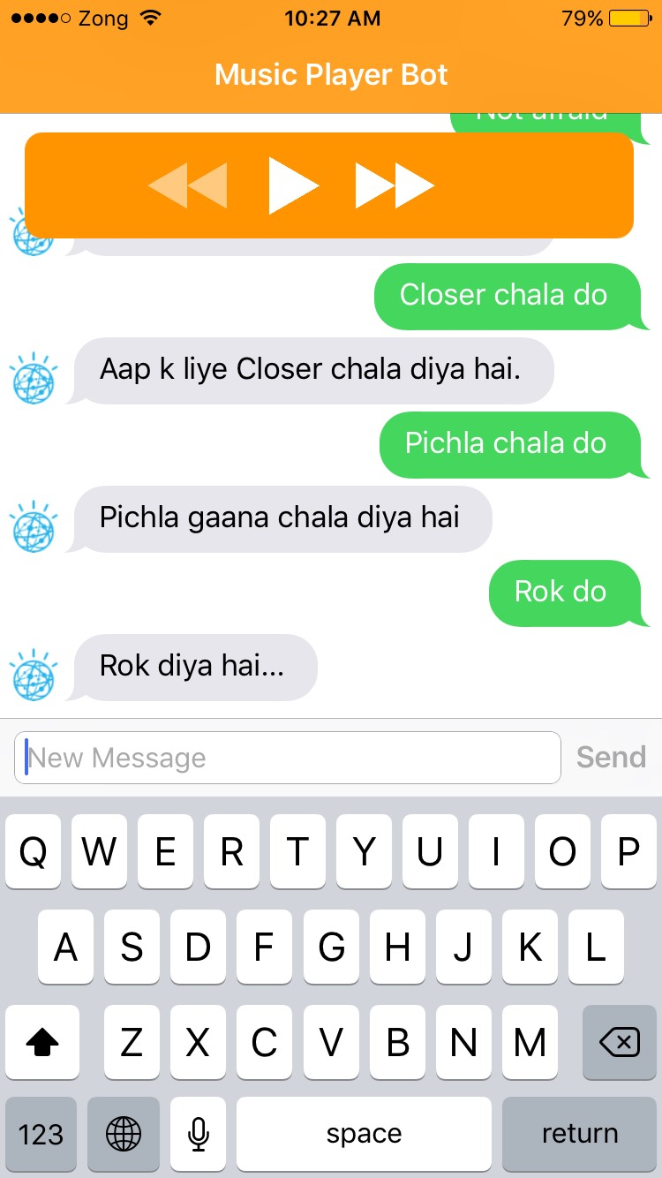
The Application (Media Player Bot)
The bot understands if you want it to stop the song.
Slight variation of words can be identified

Slide 10
Rule-Based Chat-bots
Agents can transform natural user requests into actionable data.
Entities are powerful tools used for extracting parameter values from natural language inputs .
Intents represents a mapping between what a user says and what action should be taken by your software.
Actions are the steps that your application will take when specific intents are triggered by user inputs.
Contexts are strings that represents the current context of the user expressions.

